Slide 1
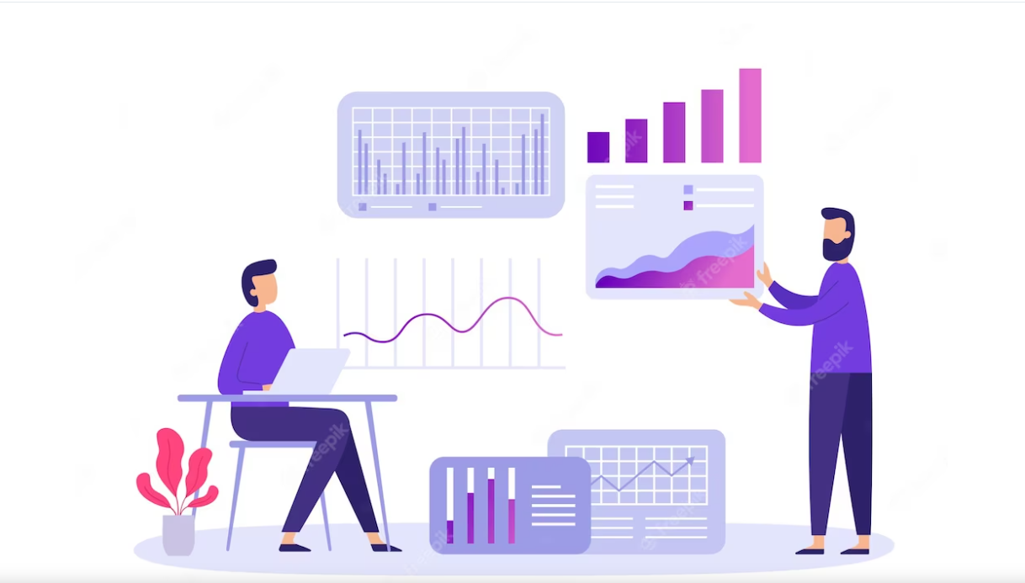
Data Analysis on Hiring Trends

Slide 2
Data Extraction
The data extraction process in this project utilizes Selenium and BeautifulSoup. Follow these steps to understand the data extraction process:
The scrapper.py script uses Selenium to automate the browser and navigate to Bumble Inc.'s LinkedIn page.
Once on the page, BeautifulSoup is used to extract relevant information such as hiring data, job titles, experience, and more.
Selenium interacts with the webpage elements, while BeautifulSoup parses the HTML content and extracts the desired data.
The extracted data is stored in variables or data structures for further processing and cleaning.

Slide 3
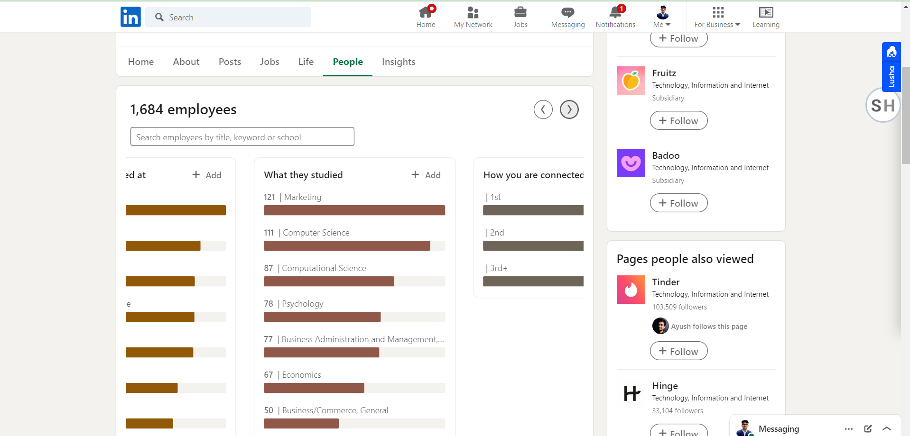
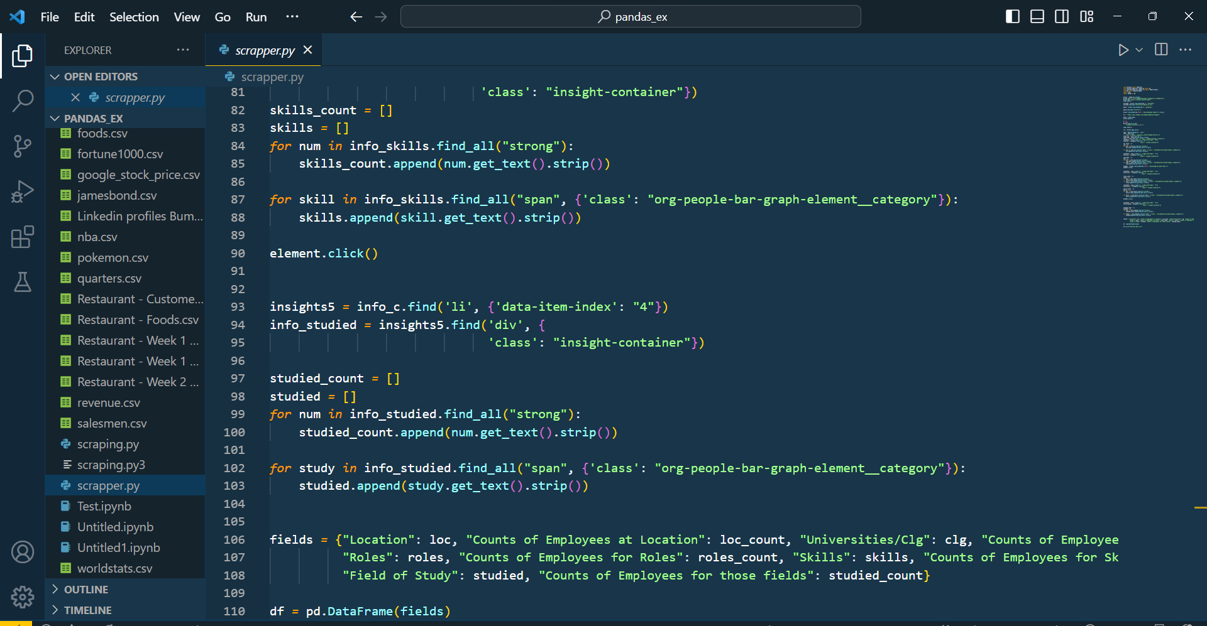

Slide 4
Data Cleaning
To clean the extracted data using Pandas, the scrapper.py script utilizes various Pandas functionalities. Follow these steps to understand the data cleaning process:
After extracting data from the website using BeautifulSoup and Selenium, the script creates a Pandas DataFrame to store the raw data.
The DataFrame allows for easier manipulation and cleaning of the data.
The script applies various cleaning techniques such as removing unnecessary columns, handling missing values, converting data types, and performing other transformations as needed.
Pandas provides functions like drop, fillna, replace, and astype to perform these cleaning operations efficiently.
Once the data is cleaned and structured, the script exports the cleaned DataFrame to a CSV file using the Pandas to_csv function.
The exported CSV file contains the cleaned and structured data, ready for further analysis and visualization.

Slide 5
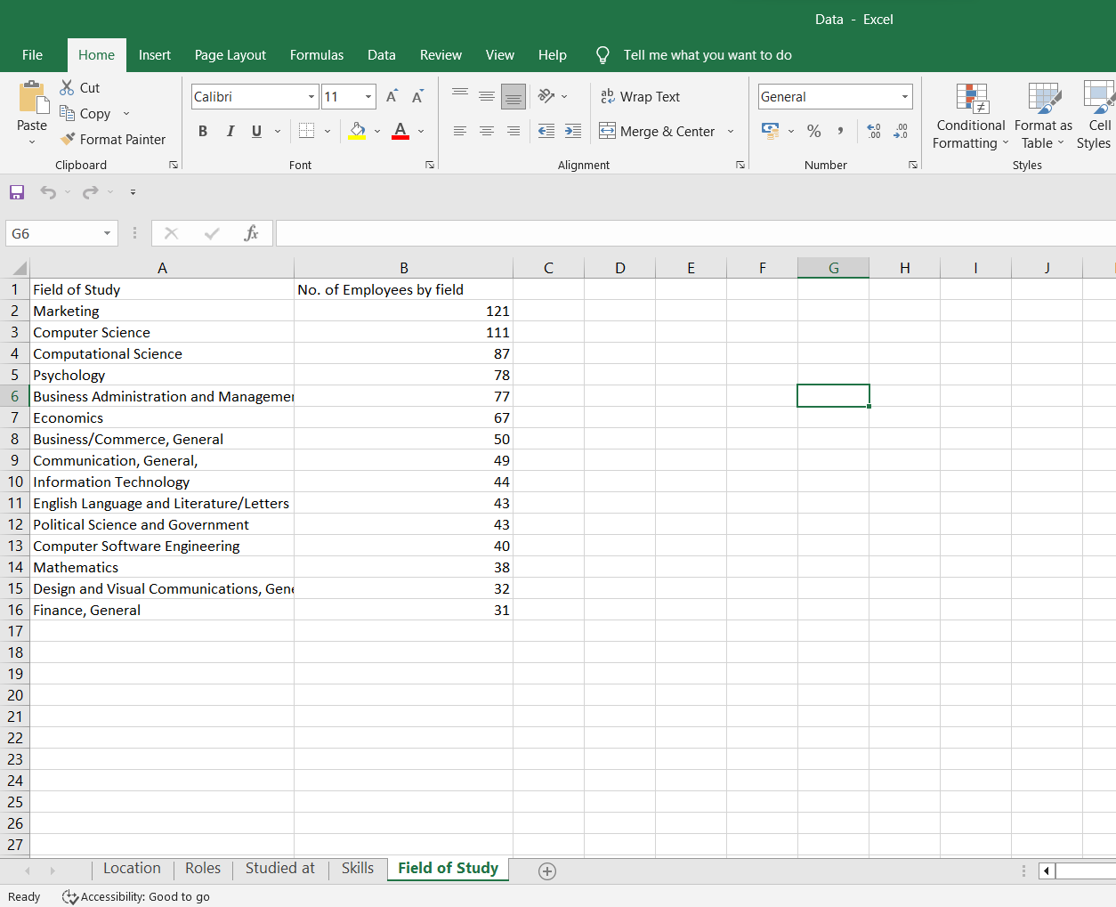

Slide 6
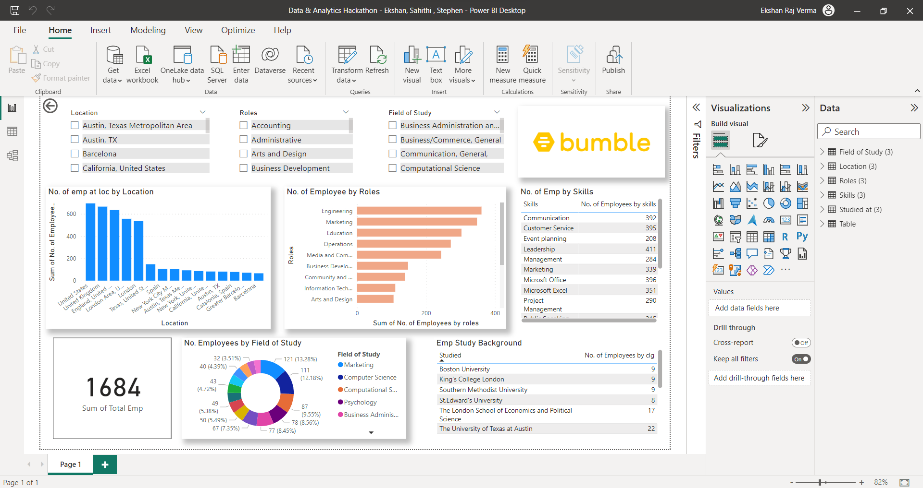
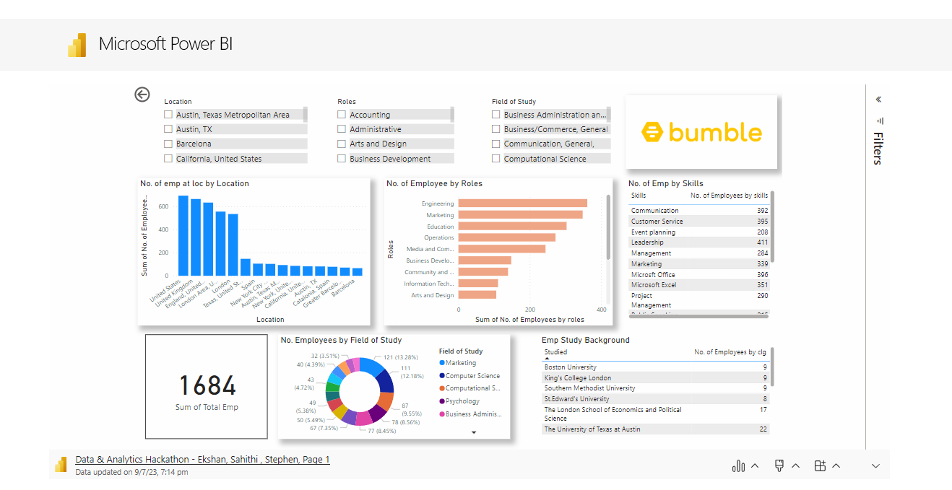
Data Visualization with Power BI
The cleaned and structured data from the CSV file can be visualized using Power BI to gain meaningful insights.
You can access the visualization in the next Slide or accessing PBIX file in Github Repo:

Slide 7

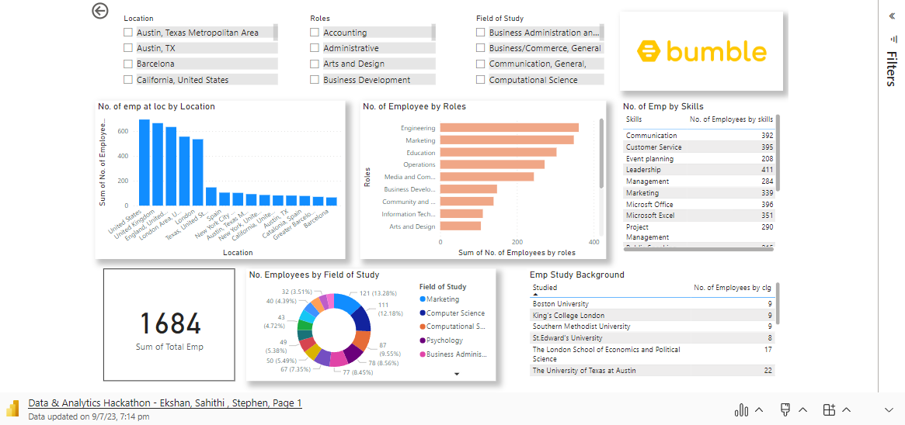
Microsoft Power BI

Slide 8
Innovative Planning and Insights
1. Location Analysis:
Identify the top locations with the highest employee counts and analyze the reasons behind their popularity. Consider factors such as local talent pool, market opportunities, or favorable business conditions.
Explore the potential for establishing satellite offices or remote work opportunities in regions with lower employee counts to tap into untapped talent markets.
Conduct a cost analysis of different locations to determine the feasibility of expanding or relocating operations.
Analyze employee retention rates and job satisfaction levels in different locations to understand the impact of the work environment on employee performance and engagement.
Consider implementing location-based perks or incentives to attract and retain top talent in competitive regions.

Slide 9
Innovative Planning and Insights
Role Analysis:
Analyze the distribution of employees across different roles to identify areas with talent shortages or surpluses.
Develop a comprehensive talent management strategy that includes succession planning, leadership development, and skills gap analysis to ensure a robust talent pipeline for critical roles.
Implement cross-training programs or job rotation initiatives to enhance employee skills and enable career development opportunities.
Conduct regular assessments of job roles to ensure they align with evolving industry trends and emerging skill requirements.
Leverage data-driven insights to optimize resource allocation and workforce planning based on projected business needs and employee capabilities.

Slide 10
Innovative Planning and Insights
University/College Analysis:
Identify universities or colleges that consistently produce employees with high performance and valuable skills.
Establish partnerships with these educational institutions to foster talent pipelines and provide internship or mentorship opportunities.
Leverage alumni networks to promote the organization's brand and attract top talent from these universities or colleges.
Develop customized recruitment strategies tailored to the characteristics of each university or college to increase the chances of attracting high-potential candidates.
Consider sponsoring or participating in career fairs, campus events, or guest lectures to raise awareness about the organization and create a strong employer brand.

Slide 11
Innovative Planning and Insights
Skills Analysis:
Identify the most in-demand and emerging skills within the organization and align training and development programs to meet those needs.
Foster a culture of continuous learning and skill development by providing employees with access to online courses, workshops, or mentorship programs.
Encourage knowledge sharing and collaboration among employees to leverage existing skills and promote a learning ecosystem within the organization.
Consider implementing skill-based incentive programs to reward employees for acquiring and utilizing new skills.
Monitor industry trends and disruptive technologies to proactively identify emerging skill requirements and prepare the workforce for future challenges.

Slide 12
Innovative Planning and Insights
Field of Study Analysis:
Analyze the distribution of employees across different fields of study to understand the diversity and expertise within the organization.
Identify potential synergies and opportunities for interdisciplinary collaboration among employees from different fields.
Foster a culture of knowledge exchange and cross-pollination of ideas to leverage diverse perspectives and promote innovation.
Develop targeted recruitment strategies to attract talent from specific fields of study that align with the organization's strategic goals and emerging industry trends.
Consider establishing partnerships with academic institutions or research organizations to engage in joint projects or research initiatives that align with the organization's field of study expertise.

Slide 13
Future Scope of Project
Data Exploration and Preprocessing:
Expand the dataset by collecting and incorporating additional relevant data from various sources.
Perform exploratory data analysis to gain deeper insights into the relationships between different data fields.
Preprocess and clean the data to ensure its quality and consistency for the recommender system.
Feature Engineering:
Conduct feature engineering to extract and create new meaningful features from the existing data.
Explore techniques such as text mining, natural language processing (NLP), or sentiment analysis to derive additional insights from textual data fields.
Incorporate domain-specific knowledge and industry expertise to create relevant features that capture the nuances of the hiring process.

Slide 14
Future Scope of Project
Recommender System Development:
Choose an appropriate recommender system algorithm based on the nature of the problem and available data.
Implement collaborative filtering, content-based filtering, or hybrid recommender system techniques to generate personalized recommendations for various stakeholders (e.g., hiring managers, recruiters, candidates).
Utilize machine learning or deep learning algorithms to train the recommender system model using historical data to predict preferences or matches.
Continuously refine and optimize the recommender system based on user feedback and performance evaluation metrics.

Slide 15
Future Scope of Project
Recommendation Use Cases:
Provide personalized job recommendations to candidates based on their skills, experience, and preferences, improving their job search experience and increasing the likelihood of finding suitable positions.
Enable hiring managers or recruiters to receive recommendations on top candidates based on job requirements, skills, and cultural fit, enhancing the efficiency of the hiring process.
Offer insights and recommendations to HR teams and management regarding talent acquisition strategies, diversity initiatives, or skill gap analysis.

Slide 16
Future Scope of Project
Evaluation and Iteration:
Establish evaluation metrics to measure the performance and effectiveness of the recommender system.
Conduct A/B testing or user studies to validate the quality and relevance of the recommendations.
Continuously iterate and enhance the recommender system based on user feedback, evolving data patterns, and changing business needs.

Slide 17

THANK YOU
Sahithi Pajjuri : Data Visualization
Ekshan Raj Verma : Data Extraction
Stephen Vs: Data Cleaning

